Slide 1
Android Application Code Review Hongyu Ye

Slide 2
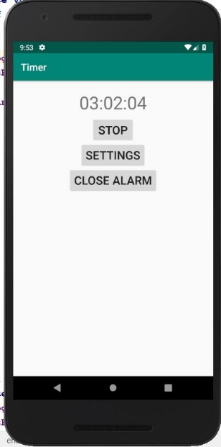
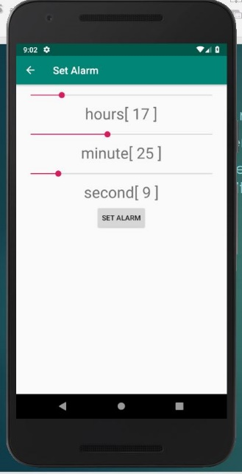
Utility App – Countdown Timer

Slide 3
Code Review
handler.postDelayed(new Runnable() { @Override public void run() { if (isRunning) { if (timerTime > 0) {//counting down the time timerTime = countdown.tick(timerTime); display.setText(TimeFormatter.getNormalTypeOfTimerTime(timerTime)); handler.postDelayed(this, 1000); } else { //the set time end, play the alarm isRunning = false; alarming(); vibrating(); } } } }, 1000);

Slide 4

Education Games: Why Mobile learning
Learning should be based on one natural interest and motivation to learn.
Kids will learn through graphics.
Open kids mind and motivate for new stages.
Since the target market was a younger demographic - choices to keep to a simple and low-text interface was necessary.

Slide 5
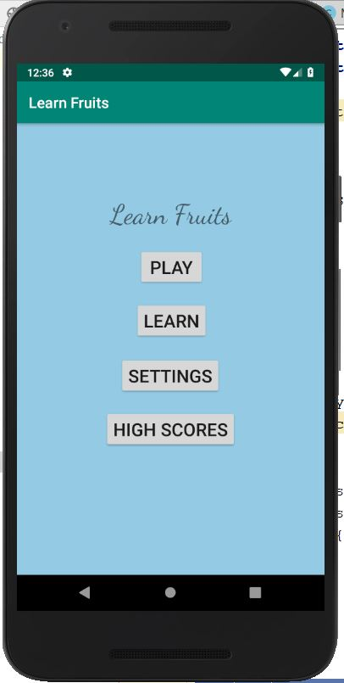
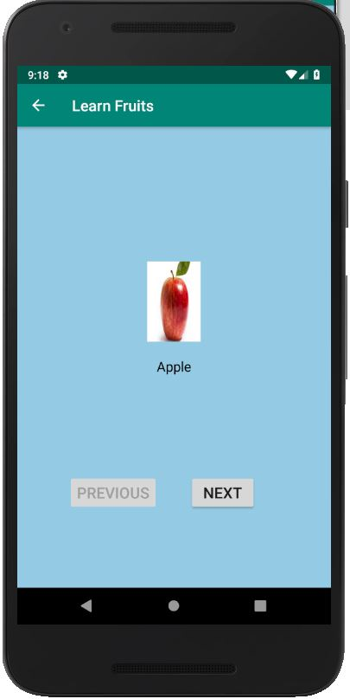
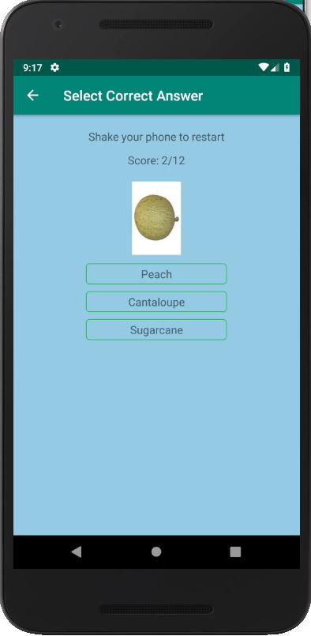
Educational Game – Learn Fruits

Slide 6
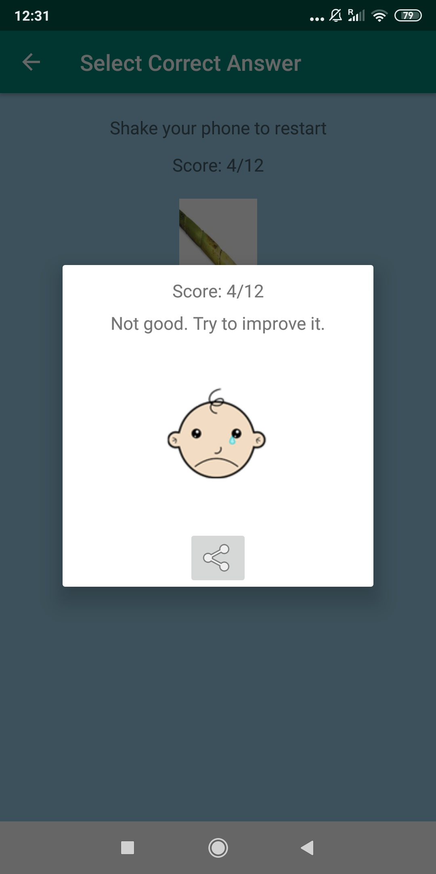
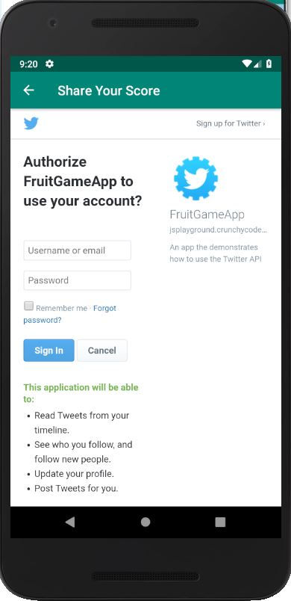
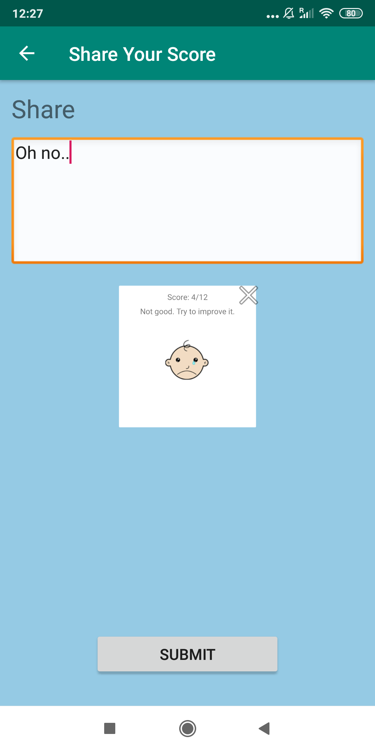
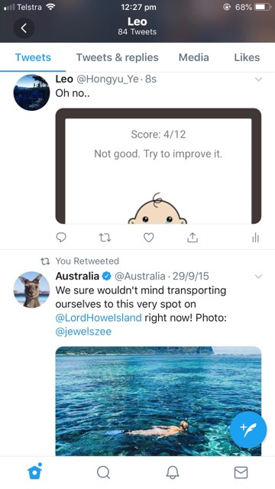
Educational Game – Learn Fruits

Slide 7
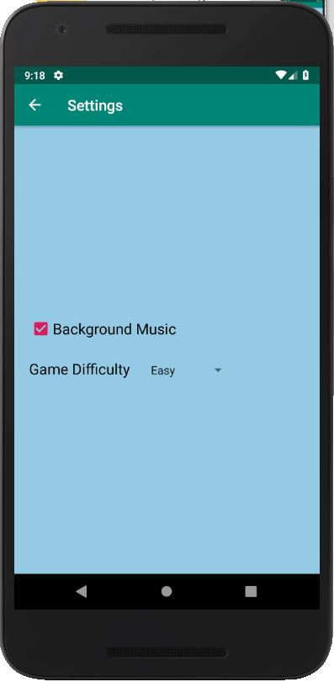
Educational Game – Learn Fruits

Slide 8
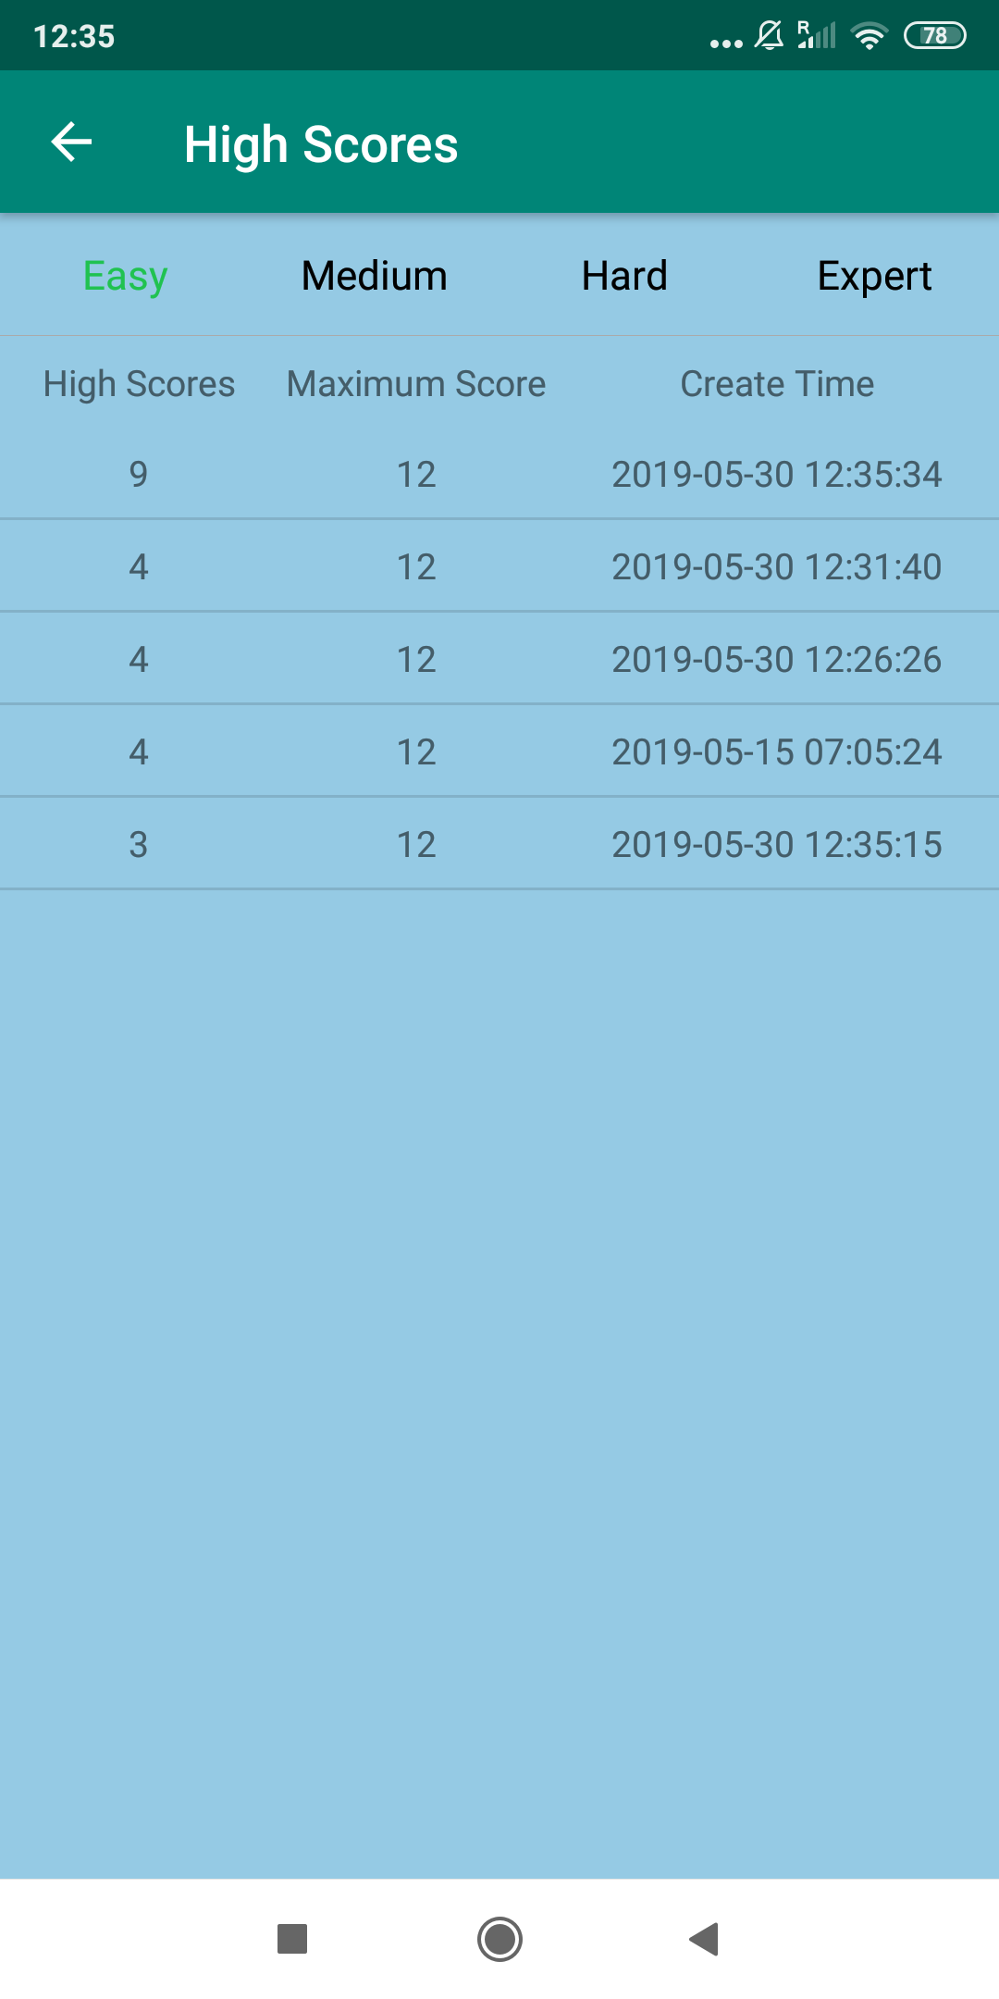
Educational Game – Learn Fruits

Slide 9
Code Review
Question[] questions = new Question[questionTotal];
//get the position of the picture
Set<Integer> positionSet = new HashSet<>();
while (positionSet.size() < questionTotal) {
int position = new Random().nextInt(celebrityManager.count());
positionSet.add(position);
}

Slide 10
Code Review
Integer[] positionArray = positionSet.toArray(new Integer[positionSet.size()]);
//generate random choices
for (int i = 0; i < questions.length; i++) {
String name = celebrityManager.getName(positionArray[i]);
Bitmap bitmap = celebrityManager.get(positionArray[i]);
Set<String> answers = new HashSet<>();
//add the correct answer to the choices
answers.add(name);
while (answers.size() < optionsCount) {
int j = new Random().nextInt(celebrityManager.count());
String answerName = celebrityManager.getName(j);
answers.add(answerName);
}
questions[i] = new Question(name, bitmap, answers.toArray(new String[answers.size()]));
}

Slide 11
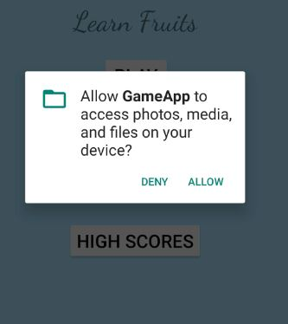
Code Review
AndroidMenifest.xml is a markup language file, having all java or activity or fragment file configuration file.
App needs permission to access photo, media and files.
Event Handling tab like Button, textview, imageView and others.
Activity having onCreate() is a event start method.
Interface to declare method.

Slide 12
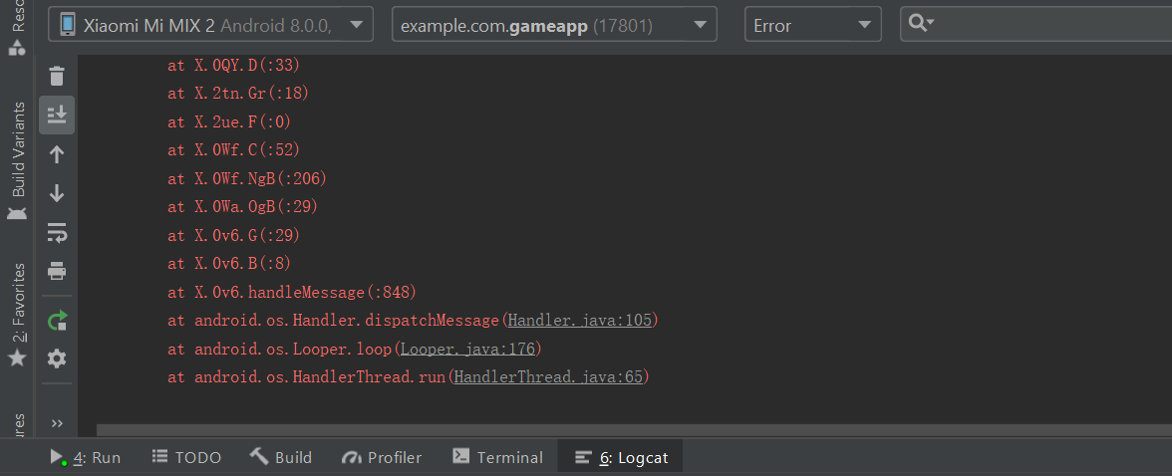
The Use of Android Studio

Slide 13
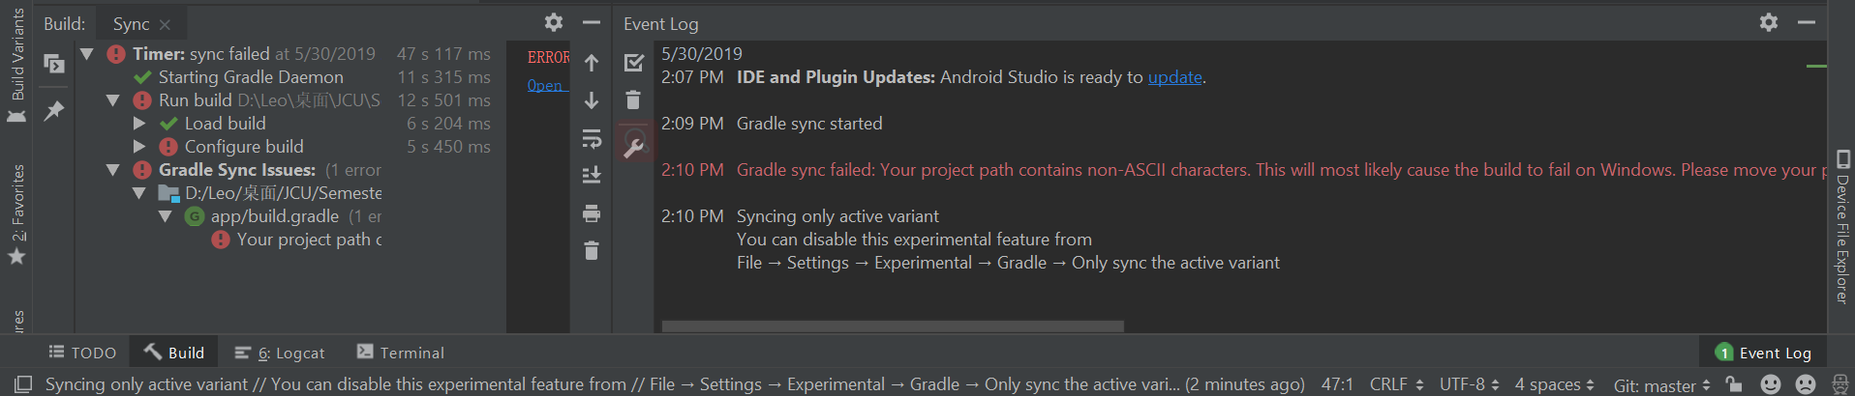
The Use of Android Studio

Slide 14
Life as a mobile developer
1. app design
2. software design
3. coding
4. native app writing ability
5. backend web services knowledge
6. knowledge of ux and ui
7. unit tests, automation, and code reviews
8. creativity and brainstorming
9. oganization and ability to multi-task
10. willingness to learn new technology
11. APIs
12. complex problem solving

Slide 15
Thank you

